Slide 1
Responsible Consumption and Production
Group-04

Slide 2
Group Members
1.18020062- M.S. Aamir Ali
2.18020666- S.M. Salman
3.18020836-M.D. Sutharshan
4.18020811- V.Sureshkumar
5.18020569-H.S.H.Perera
6.18020593-I.G.C.Prasad
7.18020631-R.A.S.Punsisi
8.18020275-W.H.M.Gunathilaka

Slide 3
Challenge Focused On

Slide 4
Since the modern world is merly build up on bits and bytes, the whole world has become a electronic world. So each and everyday different organizations produce tons of electronic equipments while consumers dispose same amount of broken electronic particals to the environment. Electronic waste contains number of heavy metals like copper, lead, tin ,mercurry, etc.

Slide 5
So they directly pollute the soil and water resources. This causes the less harvest of the plants as well as the living creatures in soil as they are dying due to the poisonous elements produced from these waste. Water with heavy metals cause diseases in kidney and Sri Lanka is facing this issue in great stake. So it is necessary to manage E-waste wisely and effectively.

Slide 6
Challenges
Insufficient formal mechanisms for E-waste collection
Lack of trained manpower for E-waste handling
Lack of of proper policies and regulations on E-waste management
Informal sectors involved in E-waste collection
Unavailability of a comprehensive E-waste management system
Most of the electronic item vender companies do not provide take back offers through their distributors and channel partners

Slide 7
Existing Literature
and Projects

Slide 8
Sri-Lanka
National Corporate E-waste Management Program-Collection Centers
E-Waste Management as an aspect of integrated solid waste management
National Electronic waste management week
Pilot schemes
Establishment of a solid waste management system
Customs and Import Controls
E-Products and waste stream tracking system
Recycling Operations and proper residual management
ReEB Waste newsletter
Granting Awards

Slide 9
Other Countries
Take-back systems
Special collection points for E-waste stream
Ad-hoc E-waste collection campaigns
Recycling centres
Several developing countries banned the imports of E-waste (Nigeria, Cambodia, China, Vietnam, Malaysia, Pakistan)
Separate collection of E-waste
Japan has developed a legislative system for E-waste management
Specific programs are developed for supporting manufacturers in designing greener electronic products: the aim is to prevent and reduce these waste flows

Slide 10

Suggested
Solution

Slide 11
Solution for the problem is “Eco-green”
Eco-green is established with a motive of creating a web-based platform for all waste emitters, also known as producers, waste consumers, the general public, recycling organizations and the government
This acts as a platform for the general public to be aware and find the parties who collect e-waste materials which they need to be removed. The system will help recycling organizations, producers to find who are capable of providing e-waste materials they require

Slide 12



MOCKUPS

Slide 13

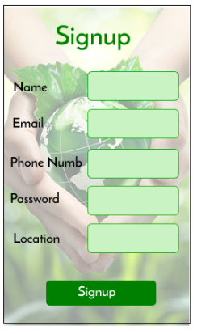
User mockups

Slide 14
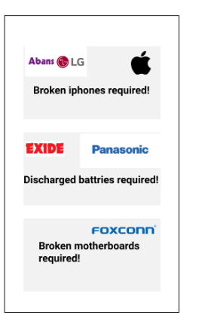
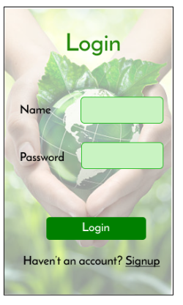

Slide 15
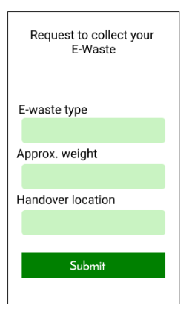


Slide 16
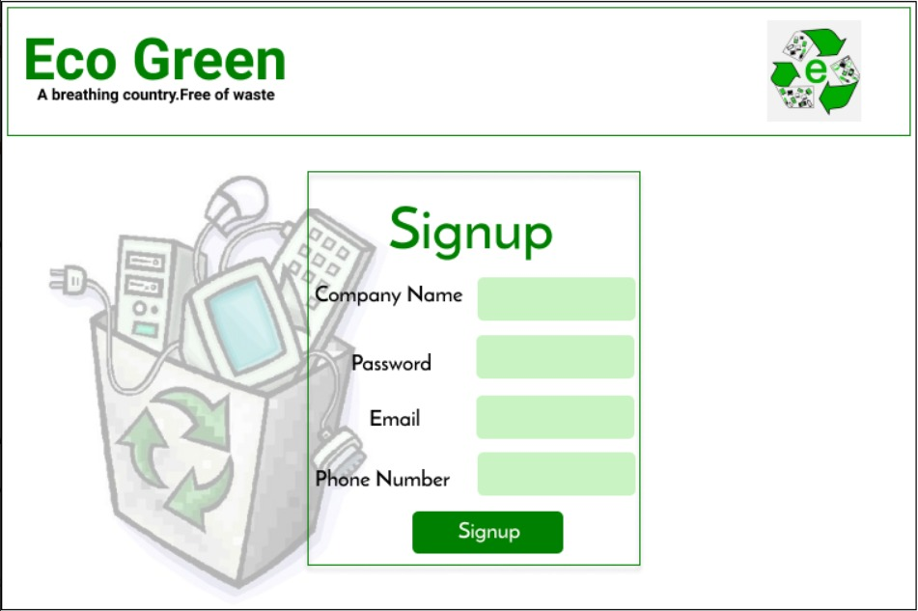
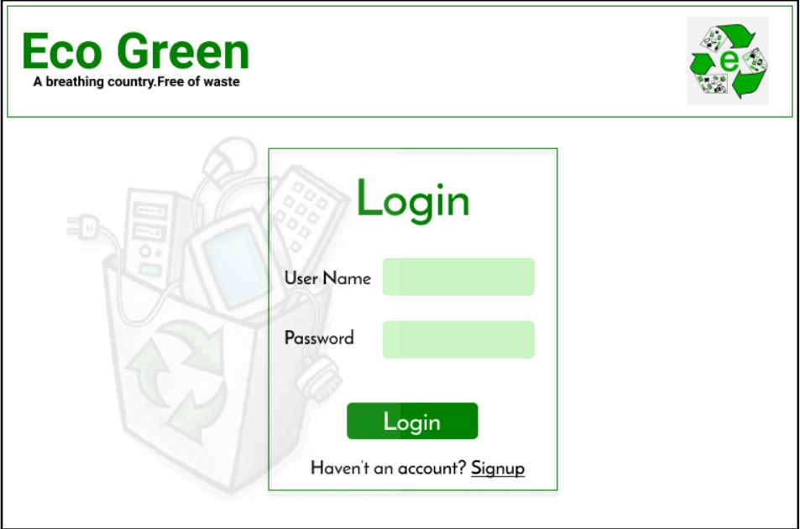
Admin mockups

Slide 17
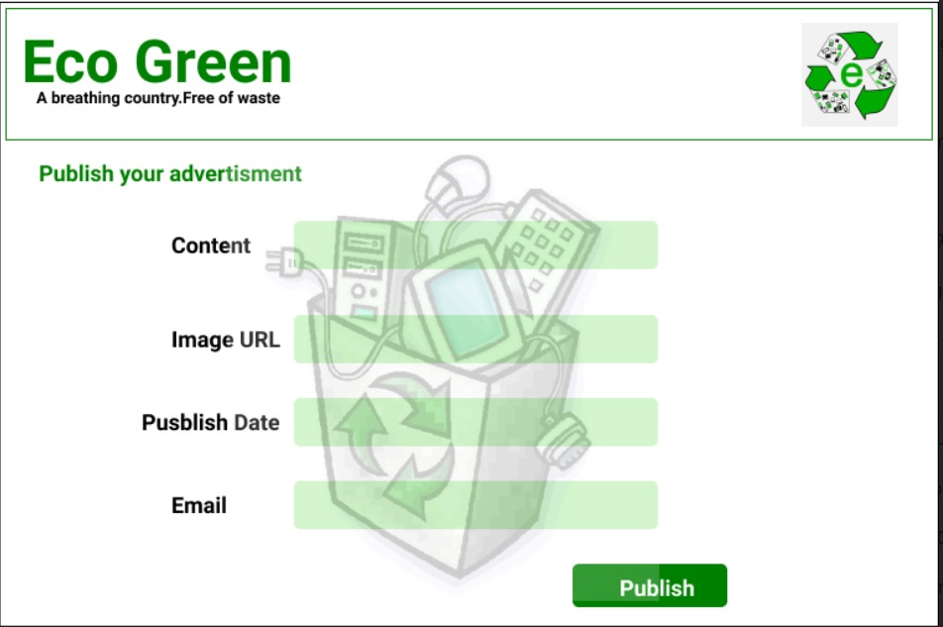
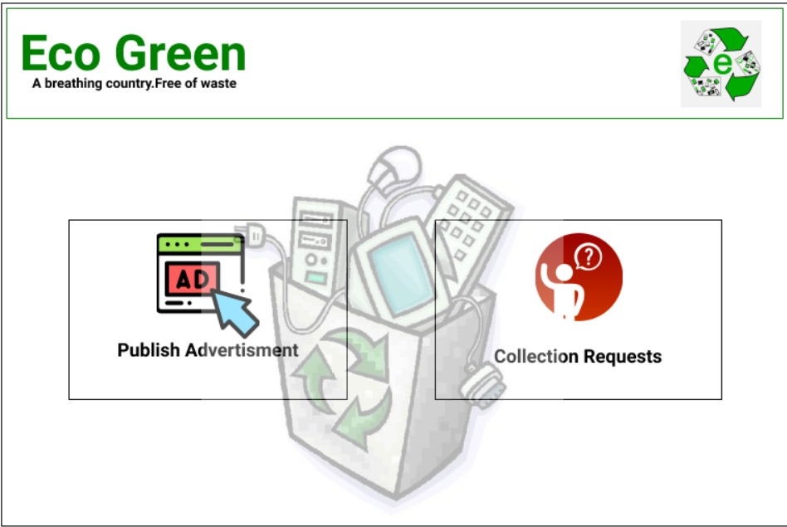

Slide 18
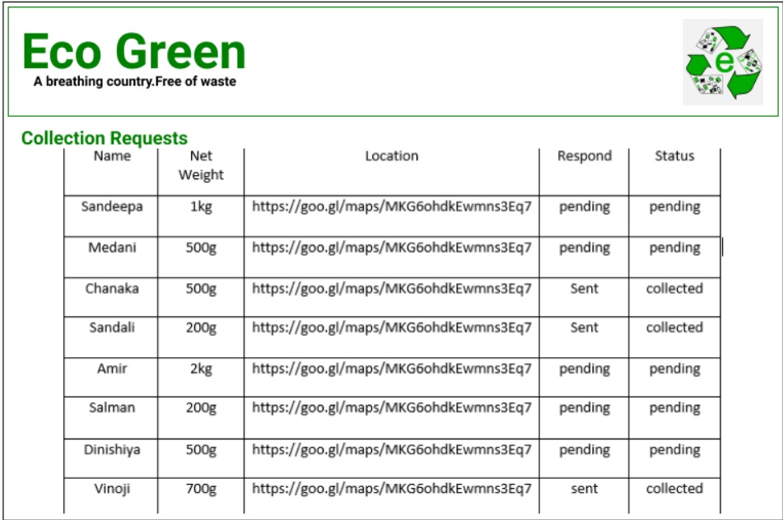

Slide 19
Design Thinking and Digital Development Principles
Applied

Slide 20
Digital Development Principles
Understand the existing ecosystem
Design for scale
Be data driven
Reuse and improve
Address privacy & security
Be collaborative
Build for sustainability
JUPITER
VENUS
MARS

Slide 21
Digital Thinking Principles
Empathy
Expansive thinking
Experimentation
JUPITER
VENUS
MARS

Slide 22
Key Stakeholders
and Their Categorization

Slide 23
Key Stakeholders
Waste emitters
Waste consumers
General public
Recycling organizations
The government
A government ministry(Central Environmental Authority)
NGOs. Competitor
Electronic device producers
Systems Owners
Development Team

Slide 24
Stakeholders Categorization
Digital Producers
Innovators: System Owners.
Enabler: System Analyst.
Creator: Development Team.
Digital Consumers
Active Users: Waste Emitters, Watse consumers.
Passive Users: Recycling Organization.
Intermediate Consumers: The Government, NGOs, Central environmental Authority.
Digital non-user
Indirect: Competitors, Electronic Device Producers.
Delinked: General Public.

Slide 25

Potential Digital Devices and Communications

Slide 26
Desktop computers
Laptop computers
Smart mobile phones
Tablet computers
e-readers
Input devices, such as keyboards, mice, and scanners.
Output devices such as printers and speakers.

Slide 27
FEASIBILITY STUDY

Slide 28
Technical Feasibility
MERN - Web development
MongoDB - DB client
Express js - Backend framework
React - Front end UI components
Node.js - Backend programming environment
Considering the facts stated above, we can conclude that this system is technically feasible.

Slide 29
Social Feasibility
Privacy and trust in information collection and use of information
The sensitive data user adds to the system will not be sold to any third party nor used for targeted advertising from external parties and will not be visible to anyone without the user's permission.
User handling
The administration has access to remove offensive or fake users who will cause harm towards the process of the system.
Copyright
All resources used are either open-source or used with proper attribution to the original author.
Considering the facts stated above, we can conclude that this system is socially feasible.

Slide 30
Cultural feasibility
Collection of e-waste will not have any impact on the cultural beliefs of the general public, as it will help eliminate the electronic waste from the society in an effective manner, hence increasing the standard of their life and a promise of better health and standard living.
The planned operations of the proposed project will integrate with the local cultural beliefs and practices, and it does not interrupt the beliefs in any way.
Considering the facts above, we can conclude that this system is culturally feasible.

Slide 31
Economic Feasibility
Development cost
Development team cost - Since this is a university project, the development cost is not considered.
Consultant fees - No expense will be incurred as we have a supervisor and co-supervisor assigned for consultation
Software cost - Software cost is not considered as we are using open-source software and tools for development.
Operational cost
Domain cost - For the domain and we will have to pay a small annual subscription.
Considering the facts stated above, we can conclude that this system is economically feasible.

Slide 32
Reduction of design reality gap in developing while concentrating
on digital development principles

Slide 33
Research on local and international projects going on to understand the existing ecosystem (understanding the ecosystem)
Design for scale of population rather than concentrating on limited targeted audience (Design for scale)
Being data driven by enable users to get and access necessary information on time (Be data driven)
Reuse and improve some already existing ideas and develop our solution flexible as reusable (reuse and improve)
Issue privacy policies, terms and restrictions to address privacy and security (Address privacy and security)
Being collaborative by interconnect entities and users together (Collaborative)

Slide 34
Ensure our solution is sustainable for long term and adaptable rapid changing future environment(Build for sustainability)
Research on user requirements, give importance to user expectations and provide useful solutions(Empathy)
Analyse the problem from conceivable angles and come up with various solutions(Expansive thinking)
Find out the best solution and build an early version of the solution (Experimentation)

Slide 35

Thanks!

Slide 36

Any Questions?

